Slide 1

What is Simulation?
Chapter 1

Slide 2
Simulation Is …
Simulation – very broad term – methods and applications to imitate or mimic real systems, usually via computer
Applies in many fields and industries
Very popular and powerful method
Book covers simulation in general and the Arena simulation software in particular
This chapter – general ideas, terminology, examples of applications, good/bad things, kinds of simulation, software options, how/when simulation is used

Slide 3
Systems
System – facility or process, actual or planned
  Examples abound …
    Manufacturing facility
    Bank or other personal-service operation
    Transportation/logistics/distribution operation
    Hospital facilities (emergency room, operating room, admissions)
    Computer network
    Freeway system
    Business process (insurance office)
    Criminal justice system
    Chemical plant
    Fast-food restaurant
    Supermarket
    Theme park
    Emergency-response system

Slide 4
Work With the System?
Study the system – measure, improve, design, control
  Maybe just play with the actual system
    Advantage — unquestionably looking at the right thing
  But it’s often impossible to do so in reality with the actual system
    System doesn’t exist
    Would be disruptive, expensive, or dangerous

Slide 5
Models
Model – set of assumptions/approximations about how the system works
  Study the model instead of the real system … usually much easier, faster, cheaper, safer
  Can try wide-ranging ideas with the model
    Make your mistakes on the computer where they don’t count, rather than for real where they do count
  Often, just building the model is instructive – regardless of results
  Model validity (any kind of model … not just simulation)
    Care in building to mimic reality faithfully
    Level of detail
    Get same conclusions from the model as you would from system
    More in Chapter 12

Slide 6
Types of Models
Physical (iconic) models
  Tabletop material-handling models
  Mock-ups of fast-food restaurants
  Flight simulators
Logical (mathematical) models
  Approximations and assumptions about a system’s operation
  Often represented via computer program in appropriate software
  Exercise the program to try things, get results, learn about model behavior

Slide 7
Studying Logical Models
If model is simple enough, use traditional mathematical analysis … get exact results, lots of insight into model
  Queueing theory
  Differential equations
  Linear programming
But complex systems can seldom be validly represented by a simple analytic model
  Danger of over-simplifying assumptions … model validity?
Often, a complex system requires a complex model, and analytical methods don’t apply … what to do?

Slide 8
Computer Simulation
Broadly interpreted, computer simulation refers to methods for studying a wide variety of models of systems
  Numerically evaluate on a computer
  Use software to imitate the system’s operations and characteristics, often over time
Can be used to study simple models but should not use it if an analytical solution is available
Real power of simulation is in studying complex models
Simulation can tolerate complex models since we don’t even aspire to an analytical solution

Slide 9
Popularity of Simulation
Consistently ranked as the most useful, popular tool in the broader area of operations research / management science
  1978: M.S. graduates of CWRU O.R. Department … after graduation
    1. Statistical analysis
    2. Forecasting
    3. Systems Analysis
    4. Information systems
    5. Simulation
  1979: Survey 137 large firms, which methods used?
    1. Statistical analysis (93% used it)
    2. Simulation (84%)
    3. Followed by LP, PERT/CPM, inventory theory, NLP, …

Slide 10
Popularity of Simulation (cont’d.)
  1980: (A)IIE O.R. division members
    First in utility and interest — simulation
    First in familiarity — LP (simulation was second)
  1983, 1989, 1993: Longitudinal study of corporate practice
    1. Statistical analysis
    2. Simulation
  1989: Survey of surveys
    Heavy use of simulation consistently reported

Slide 11
Advantages of Simulation
Flexibility to model things as they are (even if messy and complicated)
  Avoid looking where the light is (a morality play):
Allows uncertainty, nonstationarity in modeling
  The only thing that’s for sure: nothing is for sure
  Danger of ignoring system variability
  Model validity
You’re walking along in the dark and see someone on hands and knees searching the ground under a street light.
You: “What’s wrong? Can I help you?”
Other person: “I dropped my car keys and can’t find them.”
You: “Oh, so you dropped them around here, huh?”
Other person: “No, I dropped them over there.” (Points into the darkness.)
You: “Then why are you looking here?”
Other person: “Because this is where the light is.”

Slide 12
Advantages of Simulation (cont’d.)
Advances in computing/cost ratios
  Estimated that 75% of computing power is used for various kinds of simulations
  Dedicated machines (e.g., real-time shop-floor control)
Advances in simulation software
  Far easier to use (GUIs)
  No longer as restrictive in modeling constructs (hierarchical, down to C)
  Statistical design & analysis capabilities

Slide 13
The Bad News
Don’t get exact answers, only approximations, estimates
  Also true of many other modern methods
  Can bound errors by machine roundoff
Get random output (RIRO) from stochastic simulations
  Statistical design, analysis of simulation experiments
  Exploit: noise control, replicability, sequential sampling, variance-reduction techniques
  Catch: “standard” statistical methods seldom work

Slide 14
Different Kinds of Simulation
Static vs. Dynamic
  Does time have a role in the model?
Continuous-change vs. Discrete-change
  Can the “state” change continuously or only at discrete points in time?
Deterministic vs. Stochastic
  Is everything for sure or is there uncertainty?
Most operational models:
  Dynamic, Discrete-change, Stochastic

Slide 15


Simulation by Hand:
The Buffon Needle Problem
Estimate π (George Louis Leclerc, c. 1733)
Toss needle of length l onto table with stripes d (>l) apart
P (needle crosses a line) =
Repeat; tally = proportion of times a line is crossed
Estimate π by

Slide 16
Why Toss Needles?
Buffon needle problem seems silly now, but it has important simulation features:
  Experiment to estimate something hard to compute exactly (in 1733)
  Randomness, so estimate will not be exact; estimate the error in the estimate
  Replication (the more the better) to reduce error
  Sequential sampling to control error — keep tossing until probable error in estimate is “small enough”
  Variance reduction (Buffon Cross)

Slide 17
Using Computers to Simulate
General-purpose languages (FORTRAN)
  Tedious, low-level, error-prone
  But, almost complete flexibility
Support packages
  Subroutines for list processing, bookkeeping, time advance
  Widely distributed, widely modified
Spreadsheets
  Usually static models
  Financial scenarios, distribution sampling, SQC

Slide 18
Using Computers to Simulate (cont’d.)
Simulation languages
  GPSS, SIMSCRIPT, SLAM, SIMAN
  Popular, still in use
  Learning curve for features, effective use, syntax
High-level simulators
  Very easy, graphical interface
  Domain-restricted (manufacturing, communications)
  Limited flexibility — model validity?

Slide 19
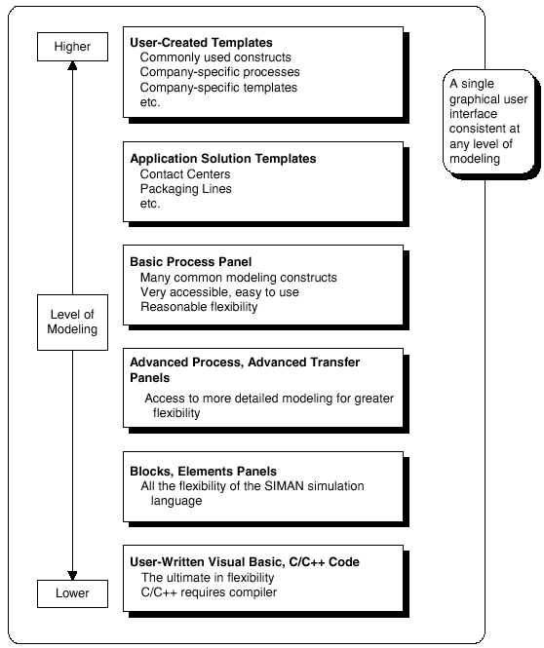
Where Arena Fits In
Hierarchical structure
  Multiple levels of modeling
  Can mix different modeling levels together in the same model
  Often, start high then go lower as needed
Get ease-of-use advantage of simulators without sacrificing modeling flexibility

Slide 20
When Simulations are Used
Uses of simulation have evolved with hardware, software
The early years (1950s-1960s)
  Very expensive, specialized tool to use
  Required big computers, special training
  Mostly in FORTRAN (or even Assembler)
  Processing cost as high as $1000/hour for a sub-286 level machine

Slide 21
When Simulations are Used (cont’d.)
The formative years (1970s-early 1980s)
  Computers got faster, cheaper
  Value of simulation more widely recognized
  Simulation software improved, but they were still languages to be learned, typed, batch processed
  Often used to clean up “disasters” in auto, aerospace industries
    Car plant; heavy demand for certain model
    Line underperforming
    Simulated, problem identified
    But demand had dried up — simulation was too late

Slide 22
When Simulations are Used (cont’d.)
The recent past (late 1980s-1990s)
  Microcomputer power
  Software expanded into GUIs, animation
  Wider acceptance across more areas
    Traditional manufacturing applications
    Services
    Health care
    “Business processes”
  Still mostly in large firms
  Often a simulation is part of the “specs”

Slide 23
When Simulations are Used (cont’d.)
The present
  Proliferating into smaller firms
  Becoming a standard tool
  Being used earlier in design phase
  Real-time control
The future
  Exploiting interoperability of operating systems
  Specialized “templates” for industries, firms
  Automated statistical design, analysis

